Slide 1
Intro to Classification & k-Nearest Neighbors

Slide 2
REVIEW: What is Supervised Learning?
Notes:
Potential opportunity to ask students what their thoughts are.

Slide 3

Supervised Learning
learn model from training data
make predictions about unseen/future data
supervised = labeled data available
e.g. price of house, emails spam/not spam, etc.

Slide 4
Supervised Learning
Use the labeled data to fit a machine learning model
Data with correct answers
model
model
fit
Notes:
The purpose of supervised learning is to build a model that will predict the labels in our data by learning from the labeled data we train on.

Slide 5
Supervised Learning
Once our model has been trained (and tested!), we can use it on unlabeled data to make new predictions.
New Data without answers
Predicted answers
model
model
predict
Notes:
Once we have built a model, we can use it on unlabeled data to make new predictions.

Slide 6
Supervised Learning
Regression: “Answers” from model are numeric
Housing Data
(with sales price)
Predicted sales price ($630k)
model
predict
Notes:
In regression models, our answers are numeric

Slide 7
Supervised Learning
Classification: “Answers” from model are categories
Email Data
(spam unknown)
Predict Spam
(yes | no)
model
predict
Notes:
In classification models, our answers are the category labels themselves.

Slide 8
Supervised Learning
Classification: “Answers” from model are categories
Image Data
(label unknown)
Predict Image
(Cat | Dog | Mouse)
model
predict
Notes:
More examples

Slide 9
Supervised Learning
Classification: “Answers” from model are categories
Breast cancer surgery data
(including survival)
Predict survival
(Survived | Lost)
model
predict
Notes:
More examples

Slide 10
Supervised Learning - Train
Model Tuning
Labels
Training Data
Machine Learning Algorithm
Predictive Model
Notes:
Overview of the training process. Take the labels and the features, train an algorithm to classify those labels as accurately as possible. Model tuning is all encompassing whether it’s hyperparameters or feature engineering, etc.

Slide 11
Supervised Learning - Predict
New Data
Labels
Training Data
Machine Learning Algorithm
Predictive Model
Prediction
Notes:
Once our algorithm is tuned, we can deploy it and have it predict new data that comes in

Slide 12
Supervised Learning - Vernacular
Observation | each data point | one row
Target | predicted property | column to predict
Label | target/category of observation | value of target column
Feature | property of observation, used for prediction | non-target columns

Slide 13




















Supervised Learning - Vernacular
1 Feature. Number of malignant nodes
2 Labels. Survived / Lost
lost
Patient 5 yrs after surgery
survived
0 10 20
Number of malignant nodes

Slide 14
Supervised Learning - Vernacular
1 Feature. Number of malignant nodes
2 Labels. Survived / Lost
Feature?
Target?
Observation?
Label?
Observation
Label
Target
lost
Patient 5 yrs after surgery
Observation
survived
0 10 20
Label
Number of malignant nodes
Feature

Slide 15


































Supervised Learning - Example
2 Features. No of malignant nodes / Age
2 Labels. Survived / Lost
60 40 20
Age
0 10 20
Number of malignant nodes

Slide 16
Supervised Learning - Example
2 Features. No of malignant nodes / Age
2 Labels. Survived / Lost
60 40 20
Age
New Observation
known: #nodes, age predict: survive | lost
0 10 20
Number of malignant nodes
Notes:
Depending on the algorithm we chose, there can be different outcomes for this new observation. Ultimately, we want a model that can make an accurate prediction for this observation based on what we have seen before.

Slide 17
k-Nearest Neighbors Algorithm

Slide 18
Tell me who you hang out with and I’ll tell you who you are.
– Everyone’s parents ... Also, KNN
Notes:
I like to use this quote to give a motivation for KNN. It’s simply, who you “hang out with” in feature space should say a lot about who you are.

Slide 19
KNN - Overview
The KNN Algorithm is fairly straightforward and can be summarized by the following three steps:
STEP 1:
Choose k and distance metric (commonly Euclidean)
STEP 2:
Find k nearest neighbors of observation to be classified
STEP 3:
Assign class label by majority vote

Slide 20
Supervised Learning - Example
Look at the nearest neighbor, predict their label
K = 1
60 40 20
Age
0 10 20
Number of malignant nodes

Slide 21
Supervised Learning - Example
Look at the nearest neighbor, predict their label
K = 1
60 40 20
Age
Predict
0 10 20
Number of malignant nodes

Slide 22
Supervised Learning - Example
Look at the two nearest neighbors, predict the label you see most
K = 2
60 40 20
Age
Predict
0 10 20
Number of malignant nodes
Notes:
By default, tie goes to the closest point

Slide 23
Supervised Learning - Example
Look at the three nearest neighbors, predict the label you see most
K = 3
60 40 20
Age
Predict
0 10 20
Number of malignant nodes

Slide 24
Supervised Learning - Example
Look at the four nearest neighbors, predict the label you see most
K = 4
60 40 20
Age
Predict
0 10 20
Number of malignant nodes

Slide 25
Supervised Learning - Example
Look at the five nearest neighbors, predict the label you see most
K = 5
60 40 20
Age
Predict
0 10 20
Number of malignant nodes
Notes:
By default, tie goes to the closest point

Slide 26
Supervised Learning - Example
Look at the six nearest neighbors, predict the label you see most
K = 6
60 40 20
Age
Predict
0 10 20
Number of malignant nodes
Notes:
By default, tie goes to the closest point

Slide 27
Decision Regions

Slide 28
Decision Regions - What are they?
In general, a machine learning classifier partitions the feature space into volumes called decision regions.
All observations inside a decision region are assigned to the same category
The decision regions are separated by surfaces called decision boundaries. These boundaries represent points where there are ties between two or more categories
Feature 2
Class 2
Class 2
Class 1
Class 1
Feature 1

Slide 29































KNN Decision Boundary
60 40
20
K = 1
Age
0 10 20
Number of malignant nodes
Notes:
The higher the K the smoother the decision boundary will be. Conversely, the smaller the K the more jagged it will be.

Slide 30
KNN Decision Boundary
60 40
20
K = 5
Age
0 10 20
Number of malignant nodes
Notes:
The higher the K the smoother the decision boundary will be. Conversely, the smaller the K the more jagged it will be.

Slide 31
KNN Decision Boundary
60 40
20
K = 34
Age
0 10 20
Number of malignant nodes

Slide 32
KNN Decision Boundary – Multiclass?
60 40
20
K = 5
Age
0 10 20
Number of malignant nodes
Notes:
The higher the K the smoother the decision boundary will be. Conversely, the smaller the K the more jagged it will be.

Slide 33
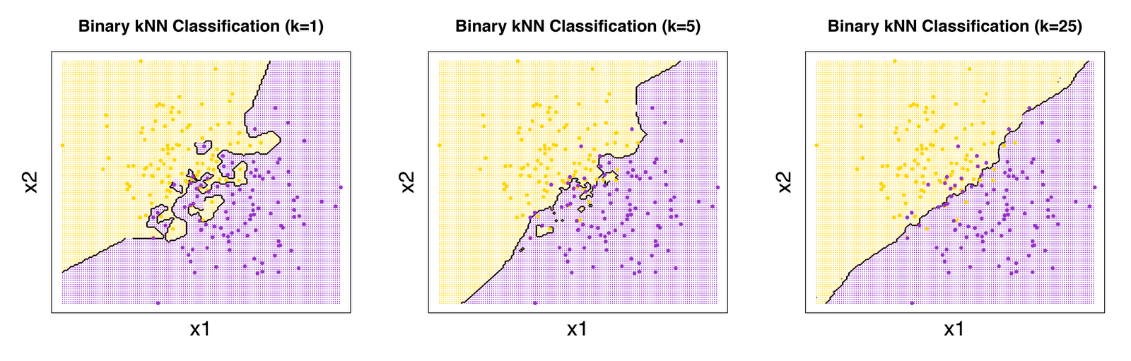
KNN Decision Boundary
k=1
k=5
k=25
Notes:
The higher the K the smoother the decision boundary will be. Conversely, the smaller the K the more jagged it will be.

Slide 34
Remember to Scale!
60 40
20
Age
012345
Number of surgeries
Notes:
KNN uses (by default) Euclidean distance. This means that if the scales between features are on different orders of magnitude (or in different units), one feature will dominate the classifier.

Slide 35
Remember to Scale!
Age
(scaled)
Number of surgeries (scaled)
Notes:
KNN uses (by default) Euclidean distance. This means that if the scales between features are on different orders of magnitude (or in different units), one feature will dominate the classifier.

Slide 36
Remember to Scale!
Age
(scaled)
Number of surgeries (scaled)
Notes:
KNN uses (by default) Euclidean distance. This means that if the scales between features are on different orders of magnitude (or in different units), one feature will dominate the classifier.

Slide 37
KNN - Overview
Pros
Easy to implement
Interpretable
Classifier adapts as new training data is collected
Cons
“Lazy” - KNN doesn’t have any “training time”, instead memorizes the training data
Memory intensive
Prediction time scales linearly as more training data is introduced

